Slide 1




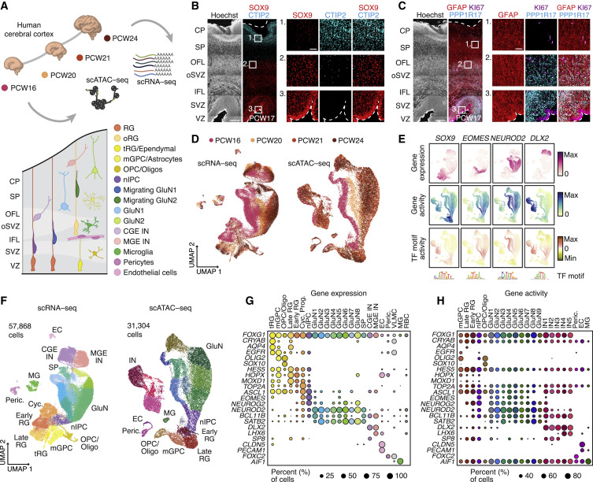
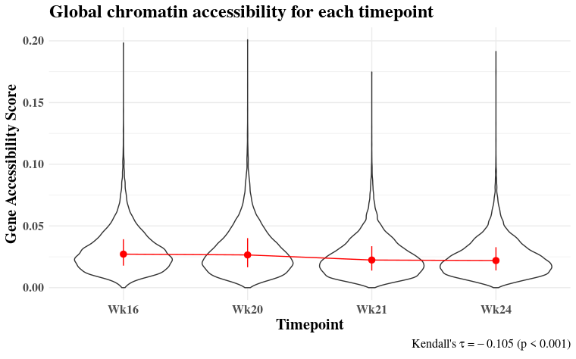
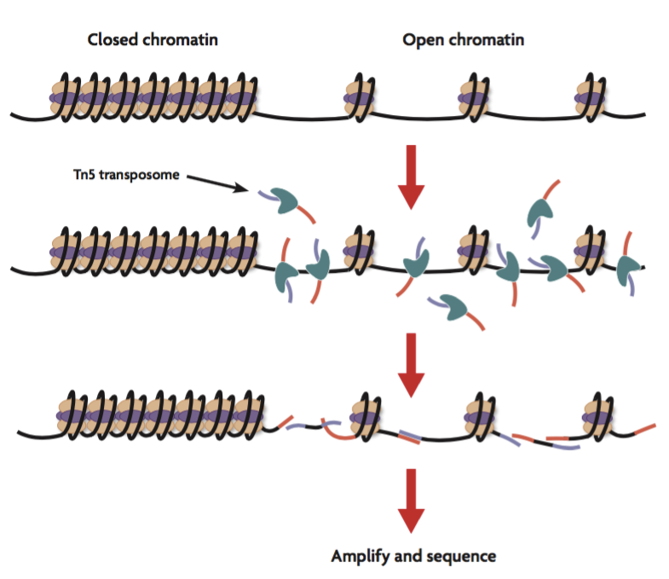
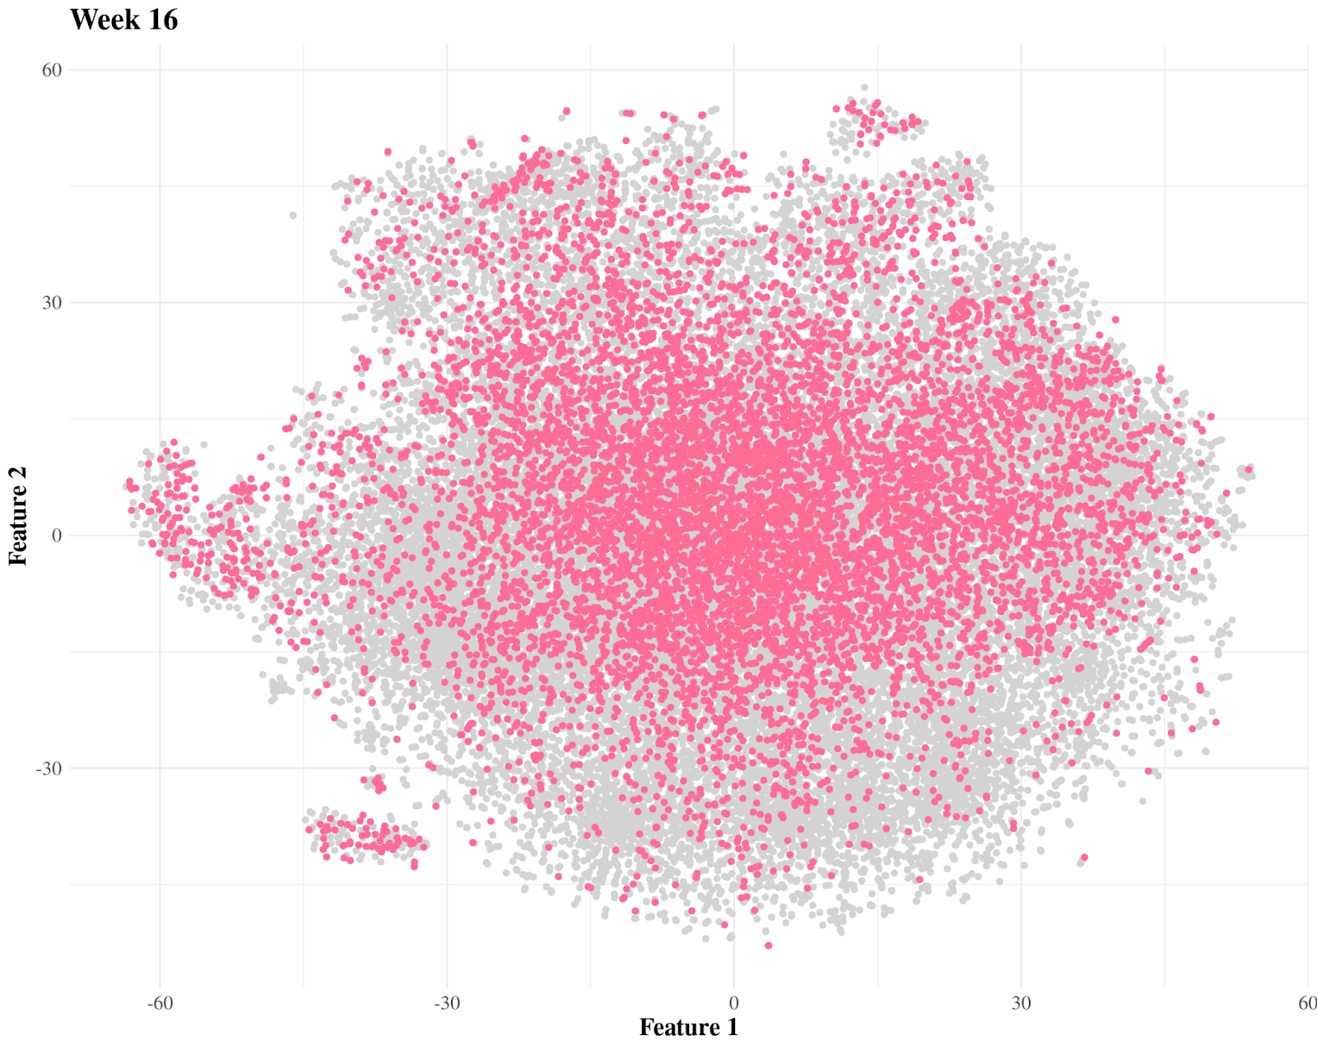
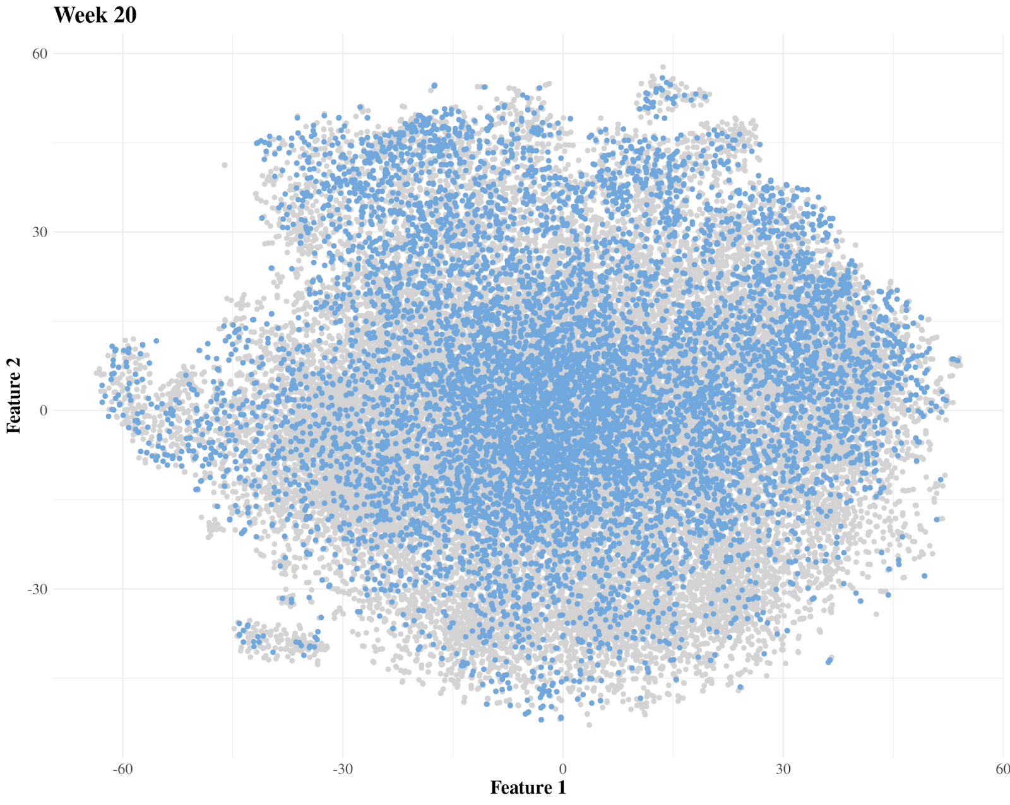
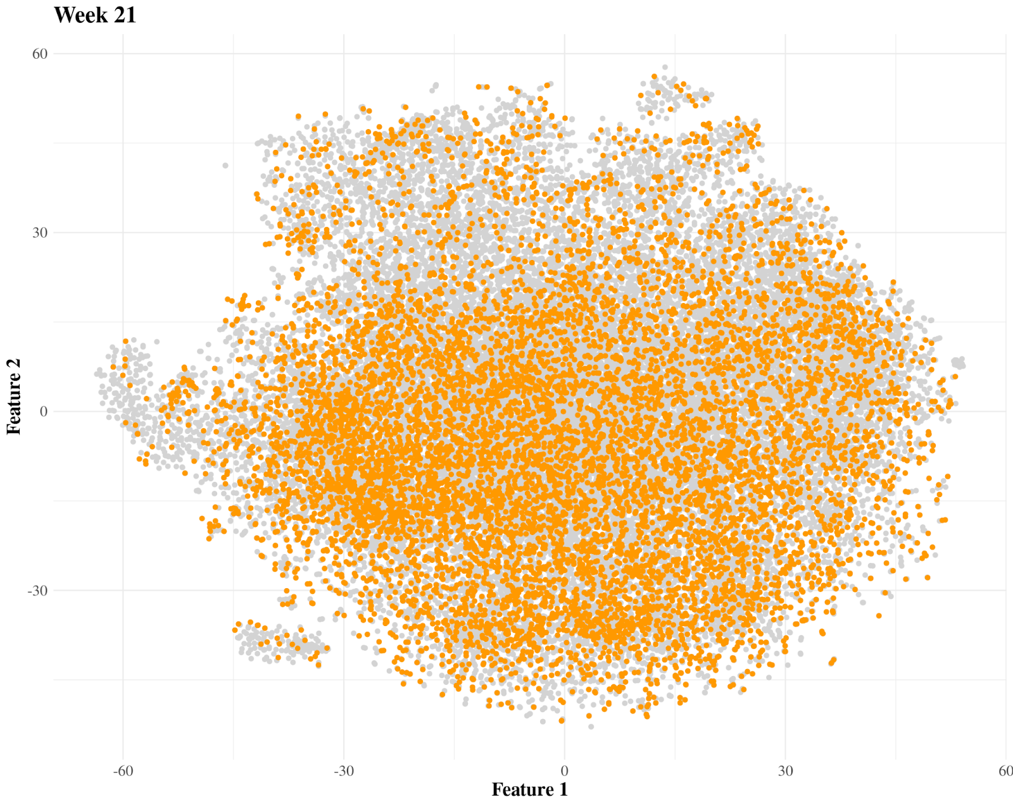
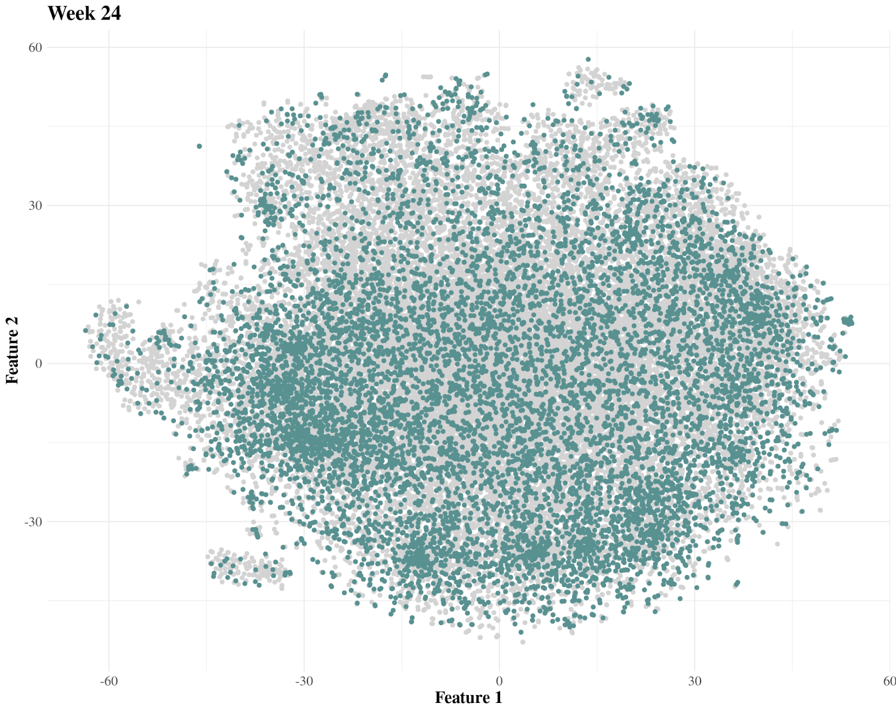
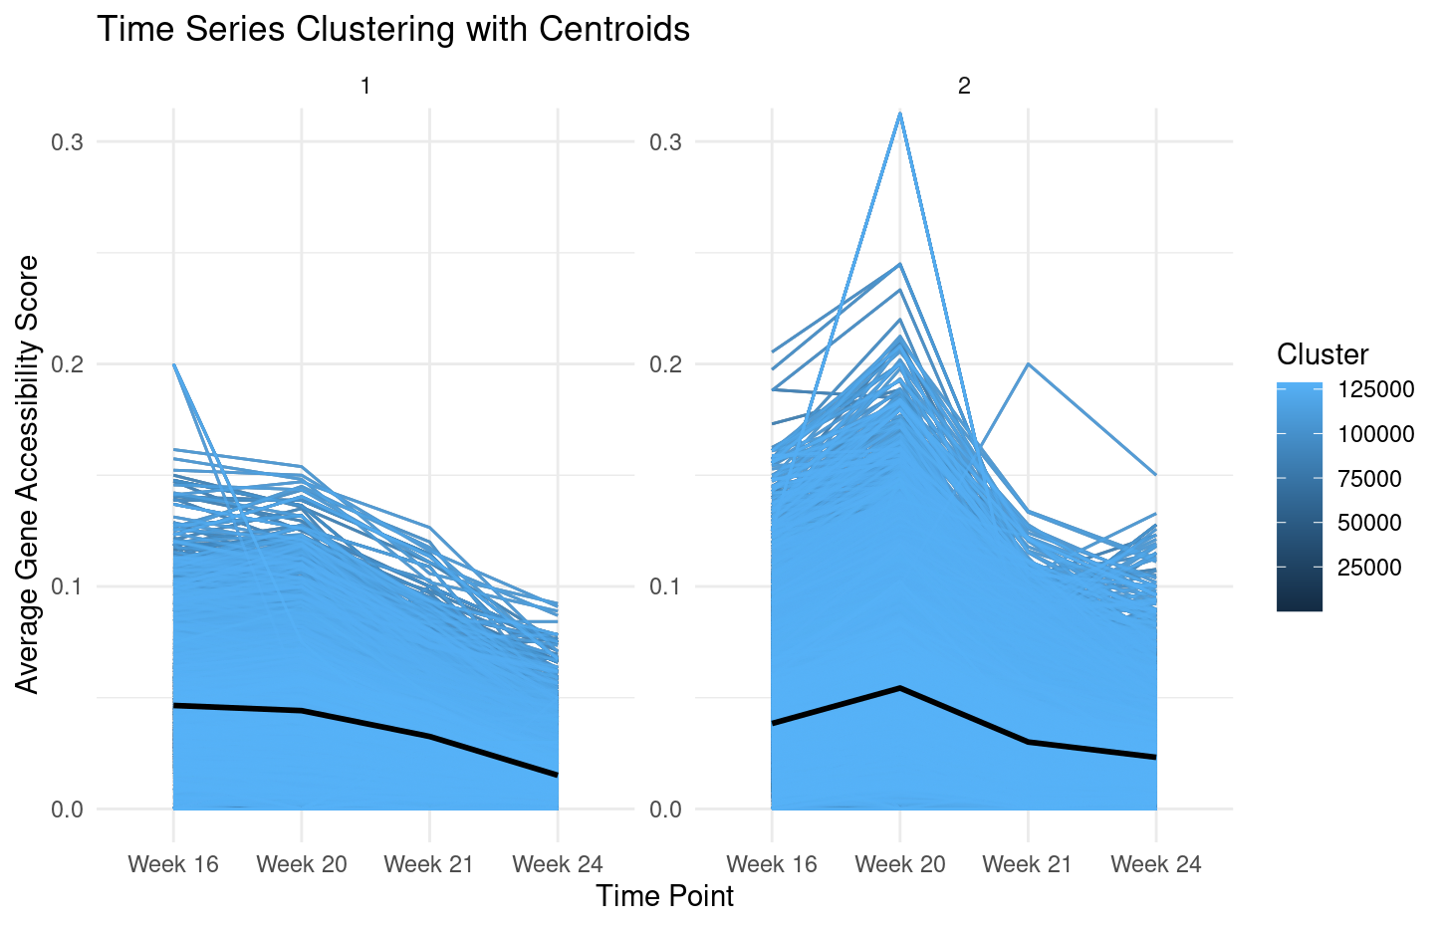
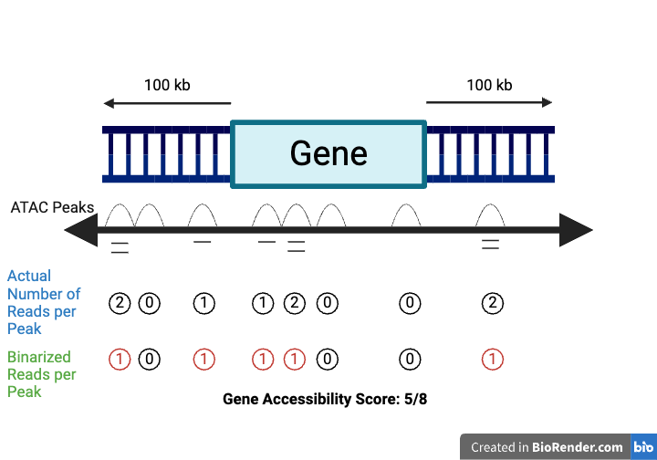
Examining changes in global chromatin accessibility in human fetal cortex cells over time
Olivia Spanish¹, Lyza Lash², and Lucy Delph³
¹Cal State University Los Angeles, ²Wayne State University, ³University of Bristol
Department of Biostatistics, University of Michigan, Ann Arbor, MI
Introduction
Results
Discussion
Chromatin, a DNA-protein complex, influences gene expression during cortex development
Gene expression fluctuation can be measured by assessing open chromatin via ATAC-seq – accessible DNA cleaved with Tn5 transposase, amplified and sequenced
Consequently, our project area focused on exploring how local and global chromatin accessibility changes over time
Our project included data collected from elective second trimester human pregnancy terminations 4 samples for 4 timepoints
Global chromatin accessibility
There is an overall slight downward trend in global chromatin accessibility, marked most notably with a shift between Weeks 20 and 21.
T-SNE plots reveal slight changes in clustering patterns over time. Clustering patterns tend to move from the middle of the full cluster of points to the periphery of the full cluster. This is shown by gradual increases in the variances of both features over time (Table 3.2).
Time-series clustering analysis indicates potential for two trends in overall chromatin accessibility. However, sensitivity analysis within the second cluster ultimately reveals close similarity between the two trends deciphered by the clustering algorithm. We conclude that time-series clustering does not reveal any novel trends regarding overall chromatin accessibility within our data.
Considering all evidence, we conclude that chromatin accessibility decreases minimally with time.
Figure 2. A violin plot of global chromatin accessibility across time points. The resulting genome-wide gene accessibility scores show a slight decrease, observationally.
Week 16
Week 20
Figure 3.1. t-SNE plots of chromatin accessibility overtime. Table 3.2. Variance of t-SNE features 1 (F₁) and 2 (F₂) overtime. Results show slight increase in clustering overtime.
Purpose of our project:
Corticogenesis lacks extensive research due to difficulty obtaining brain tissue samples. Therefore, we want to gain a better understanding of cortical diseases and cellular function by exploring gene expression changes.
Limitations
Time effect vs Sample effect – add more samples at each timepoint
Second trimester abortions are often medically indicated - may not be generalizable to normal development
Samples only span 8 weeks - add samples at earlier and later timepoints
Methods
Week 21
Week 24
Create a quantification to describe the magnitude of chromatin accessibility for all genes. See Figure 1. This establishes a positional relationship between ATAC peaks and nearby genes.
Assess changes in global chromatin accessibility through each time point.
Analyze cell clustering and specialization patterns at the global level over time through t-SNE plots.
Examine trends in global chromatin accessibility with time-series clustering to evaluate validity of observed trends in overall chromatin accessibility.
Timepoint | F₁ | F₂
Week 16 | 442 | 332
Week 20 | 475 | 425
Week 21 | 523 | 441
Week 22 | 585 | 498
Future Research
Explore why certain genes are more accessible than others, especially at Week 20
Consider using a different metric for gene accessibility
Explore clustering tendencies overtime of t-SNE plots:
Biological implications regarding how the increased variance of features relate to cell specialization over time.
Further analysis of potential cell clustering at Week 24.
Quantification Methods
Cluster 1
Cluster 2
The Gene Accessibility Score (GAC) was created to quantify chromatin accessibility, for this project. For the k-th peak out of n total peaks within 100kb of the i-th gene, we compute the following:
Acknowledgements
This research was supported in part by the National Heart, Lung, and Blood Institute (NHLBI), grant R25HL147207. Thank you to Dr. Bhramar Mukherjee, Dr. Matt Zawistowski, Dr. Xiang Zhou, Dr. Kelly Bakulski, Elysia Chou, Zheng Li, Hanna Venera, Kirill Sabitov, Sabrina Olsson, and our entire BDSI cohort!
${ GAC}_{i}= \frac{1}{n_{i}}\sum_{k=1}^{n_{i}}{X_{i,k}}$ where $X_{i,k}∈\left\{0,1\right\}$
Average Gene Accessibility Score
Average Gene Accessibility Score
Figure 1. An infographic on computing the gene accessibility score. This quantification will be used to assess chromatin accessibility.
References
Prenatal development (no date) BrainKart. Available at: https://www.brainkart.com/article/Prenatal-Development_29450/ (Accessed: 15 July 2024).
Dillinger, S. (2021) Complete guide to understanding and using ATAC-Seq, Active Motif. Available at: https://www.activemotif.com/blog-atac-seq (Accessed: 10 July 2024).
G., M. et al. (2023) Matej G., Healthiack. Available at: https://healthiack.com/encyclopedia/pictures-of-cerebral-cortex (Accessed: 16 July 2024).
Trevino AE, Müller F, Andersen J, Sundaram L, Kathiria A, Shcherbina A, Farh K, Chang HY, Pașca AM, Kundaje A, Pașca SP, Greenleaf WJ. Chromatin and gene-regulatory dynamics of the developing human cerebral cortex at single-cell resolution. Cell. 2021 Sep 16;184(19):5053-5069.e23. doi: 10.1016/j.cell.2021.07.039. Epub 2021 Aug 13. PMID: 34390642.
McNearney TA, Westlund KN. Pluripotential GluN1 (NMDA NR1): Functional Significance in Cellular Nuclei in Pain/Nociception. Int J Mol Sci. 2023 Aug 25;24(17):13196. doi: 10.3390/ijms241713196. PMID: 37686003; PMCID: PMC10488196.
Timepoint
Timepoint
Figure 4. Time-series clustering of the whole genome based on mean gene accessibility scores at each time point. Number of clusters was determined using Silhouette value, Dunn index, and Davies-Bouldin index. Clusters were assigned using partitional clustering with a shape-based distance function.

